Slide 1
You deserve …

Slide 2
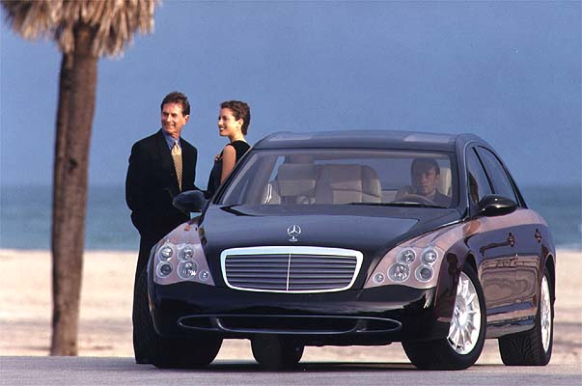
a company car…

Slide 3
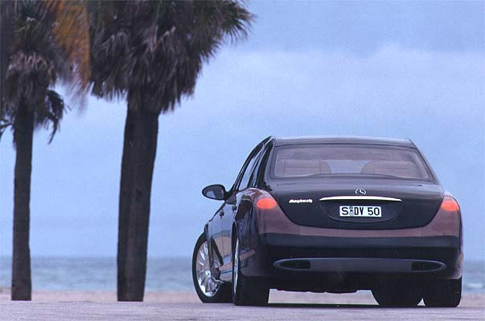
A good parking space…

Slide 4
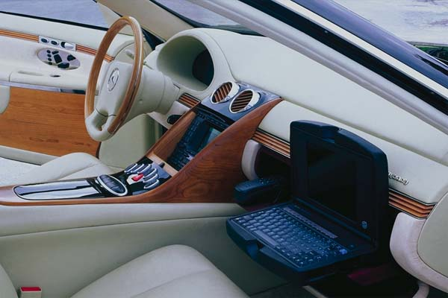
An office of your taste…

Slide 5
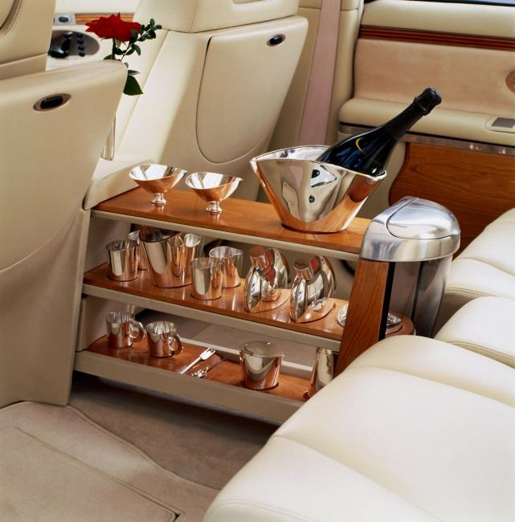
A space to rest…

Slide 6
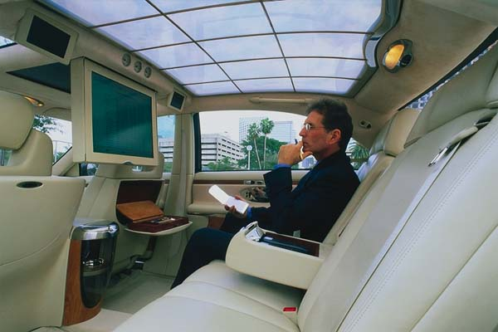
A nice meeting room…

Slide 7
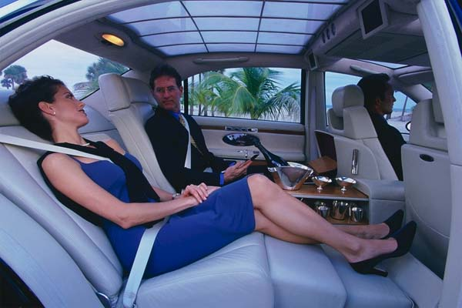
A place to exchange ideas…

Slide 8
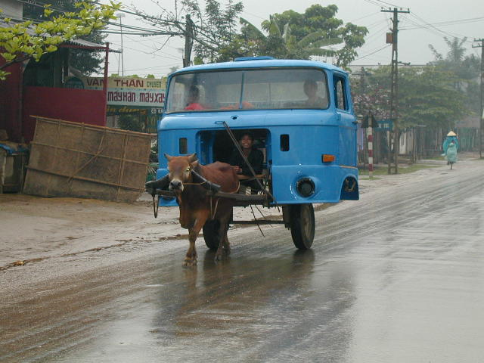
Stop dreaming and get back to work !
(and be happy with what you´ve got)

